Slide 1
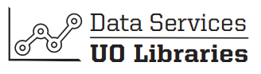
Python Workshop III Intro to Machine Learning
Data Services
February 2020

Slide 2
Workshop Prerequisites
Exposure to some coding
Ability to access Jupyter Notebooks or Google Colab

Slide 3

Workshop Agenda
$
$
$
$
$
$
$
$
$
$
What is Machine Learning?
A brief introduction to regressions
Python Exercise
Predicting AirBnB prices in Boston
Workshop GitHub
https://github.com/JMUO/PythonWorkshopSeries
$

Slide 4
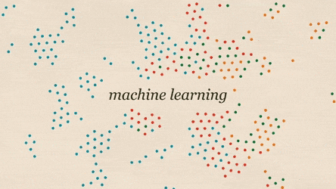

Slide 5
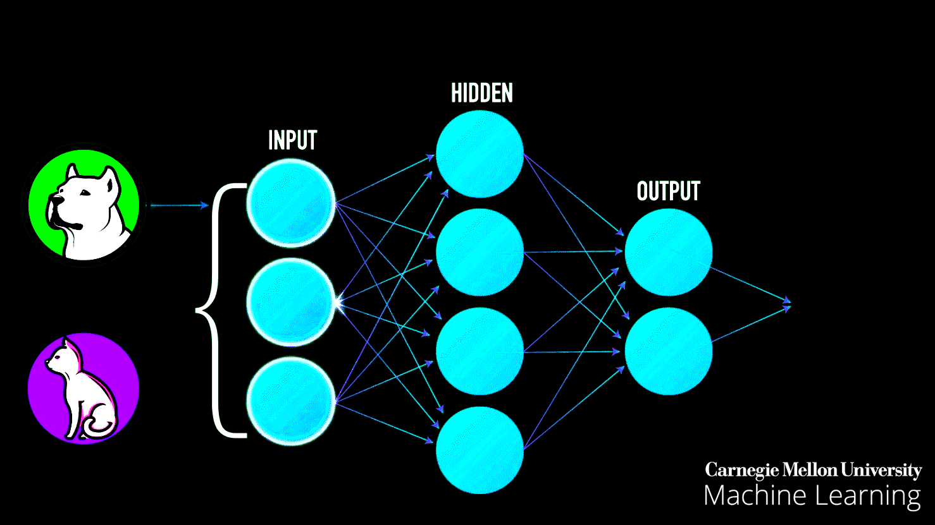
What is Machine Learning?

Slide 6
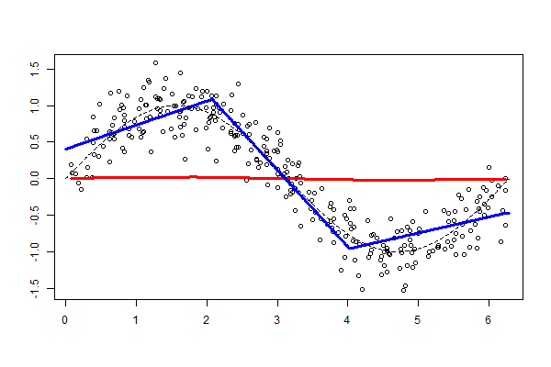
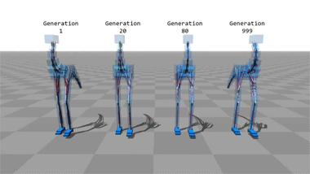
Machine Learning
Machine Learning
Making Predictions
“training” the models
Model validation
Regressions
Mechanical
Dynamic Feedback
Not AI
Artificial Intelligence

Slide 7
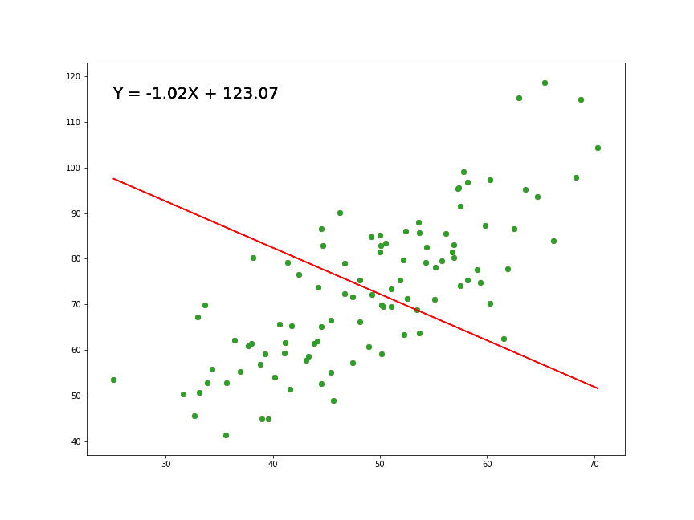
What are regressions?

Slide 8
Regressions
Minimizing error – minimizing distance in residuals
More observations -> more power and accuracy
Generate “average estimated effect”
Lots of different models and varying complexity
Time series
Experimental vs. Mechanical

Slide 9
Exercise
Predict AirBnB prices in Boston, MA
https://github.com/JMUO/PythonWorkshopSeries

